Slide 1
FoodDepot

Slide 2
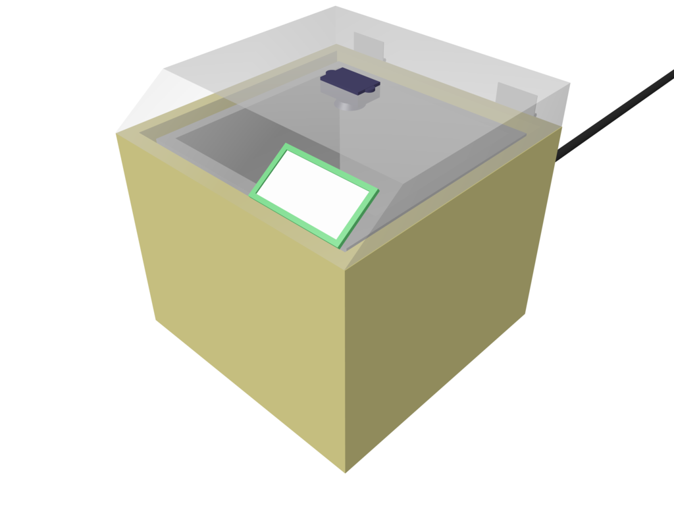

Slide 3
Sensoren
Handy
  GPS
  NFC/Camera
Box
  Kamera
  Waage
  Sensordrone

